Slide 1
Socket Programming

Slide 2
What is a socket?
Socket
The combination of an IP address and a port number.
The name of the Berkeley-derived application programming interfaces (APIs) for applications using TCP/IP protocols.
Two types
Stream socket : reliable two-way connected communication streams
Datagram socket
Socket pair
Specified the two end points that uniquely identifies each TCP connection in an internet.
4-tuple: (client IP address, client port number, server IP address, server port number)
Notes:
TLI ( Transport Layer Interface )

Slide 3
Two essential types of sockets
SOCK_STREAM
TCP sockets
reliable delivery
in-order guaranteed
connection-oriented
SOCK_DGRAM
UDP sockets
unreliable delivery
no order guarantees
no notion of “connection”
We’ll look at this one
App
App
D1
3
2
3
2
D2
1
1
socket
Dest.
socket
D3

Slide 4
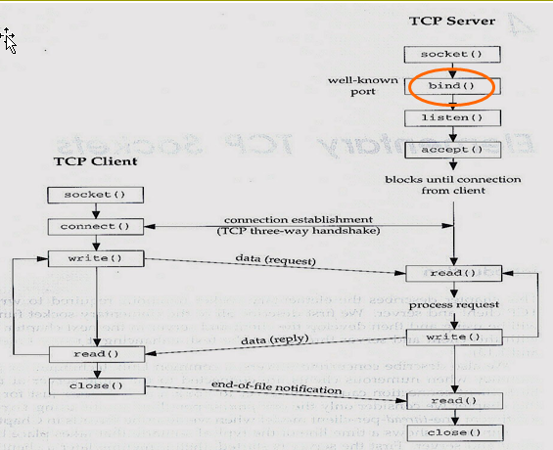
Binds a Socket to an Address

Slide 5
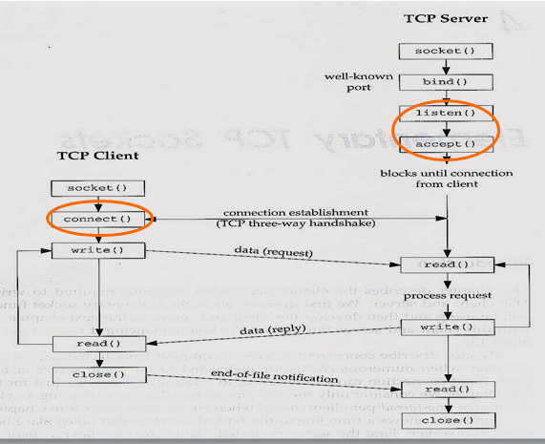
Connection Setup

Slide 6
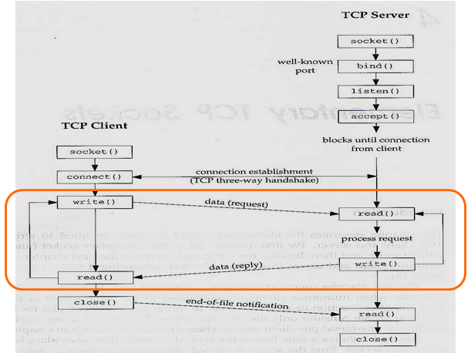
Sending/Receiving Data

Slide 7
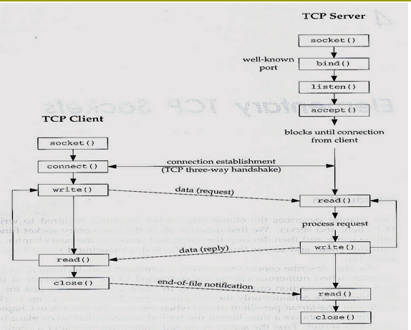
Summary

Slide 8
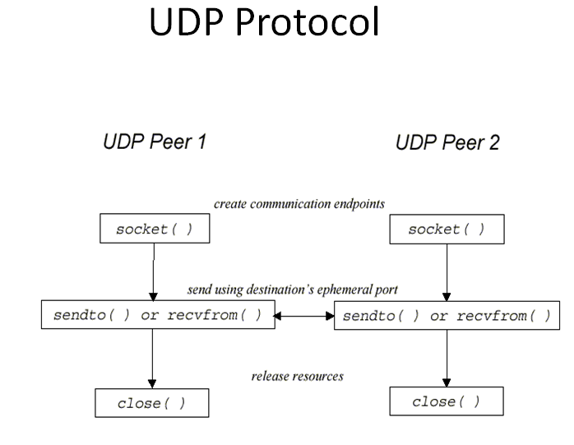

Slide 9
Java API for TCP Streams
The Java API provides TCP streams by means of two classes:
ServerSocket - This class implements server sockets. A server socket waits for requests to come in over the network.
Socket - This class implements client sockets.
ServerSocket:
accept - Listens for a connection to be made to this socket and accepts it. The result of executing accept is an instance of Socket.

Slide 10
Java API for TCP Streams
Socket:
Socket (InetAddress address, int port) - Creates a stream socket and connects it to the specified port number at the specified IP address. It will throws UnknownHostException or an IOException.
getInputStream - Returns an input stream for this socket.
getOutputStream - Returns an output stream for this socket.
Figure 4.5 shows a client program. Figure 4.6 shows the corresponding server program.

Slide 11
Java API for UDP Datagrams
The Java API provides datagram communication by means of two classes:
DatagramPacket - Datagram packets are used to implement a connectionless packet delivery service.
DatagramSocket - A datagram socket is the sending or receiving point for a packet delivery service.
DatagramPacket:
getData - Returns the data buffer.
getPort - Returns the port number on the remote host.
getAddress - Returns the IP address.

Slide 12
Java API for UDP Datagrams
DatagramSocket:
send - Sends a datagram packet from
this socket.
receive - Receives a datagram packet from this socket.
setSoTimeout - Enable/disable the specified timeout, in milliseconds.
connect - Connects the socket to a remote address for this socket.

Slide 13
Client-server applications
Implementation of a protocol standard defined in an RFC. (FTP, HTTP, SMTP…)
Conform to the rules dictated by the RFC.
Should use the port number associated with the protocol.
Proprietary client-server application.
A single developer( or team) creates both client and server program.
The developer has complete control.
Must be careful not to use one of the well-known port number defined in the RFCs.
* well-known port number : managed by the Internet Assigned Numbers Authority(IANA)

Slide 14
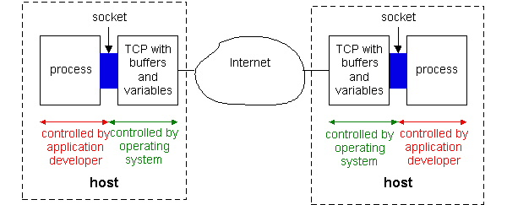
Socket Programming with TCP
Figure 2.6-1: Processes communicating through TCP sockets
The application developer has the ability to fix a few TCP parameters, such as maximum buffer and maximum segment sizes.

Slide 15
Sockets for server and client
Server
Welcoming socket
Welcomes some initial contact from a client.
Connection socket
Is created at initial contact of client.
New socket that is dedicated to the particular client.
Client
Client socket
Initiate a TCP connection to the server by creating a socket object. (Three-way handshake)
Specify the address of the server process, namely, the IP address of the server and the port number of the process.

Slide 16
Socket functional calls
socket (): Create a socket
bind(): bind a socket to a local IP address and port #
listen(): passively waiting for connections
connect(): initiating connection to another socket
accept(): accept a new connection
Write(): write data to a socket
Read(): read data from a socket
sendto(): send a datagram to another UDP socket
recvfrom(): read a datagram from a UDP socket
close(): close a socket (tear down the connection)

Slide 17
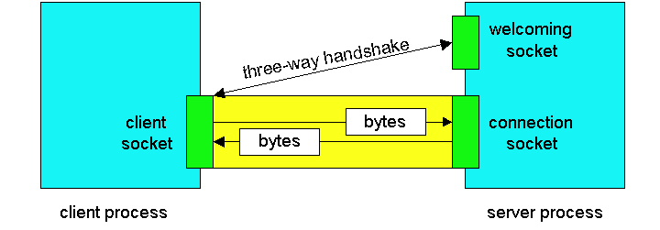
Sockets

Slide 18
Socket-programming using TCP
socket( )
bind( )
listen( )
server
client
socket( )
bind( )
connect( )
TCP conn. request
TCP ACK
accept( )
send( )
recv( )
recv( )
close( )
send( )
close( )
controlled by
application
developer
process
process
socket
controlled by
operating
system
TCP with
buffers,
variables
socket
TCP with
buffers,
variables
internet

Slide 19
Socket programming with TCP
Example client-server app:
client reads line from standard input (inFromUser stream) , sends to server via socket (outToServer stream)
server reads line from socket
server converts line to uppercase, sends back to client
client reads, prints modified line from socket (inFromServer stream)
Client
process
Input stream:
sequence of bytes
into process
output stream:
sequence of bytes
out of process
client TCP socket

Slide 20
Client/server socket interaction: TCP
Server (running on hostid)
Client
create socket,
port=x, for
incoming request:
welcomeSocket =
ServerSocket()
TCP
connection setup
create socket,
connect to hostid, port=x
wait for incoming
connection request
connectionSocket =
welcomeSocket.accept()
clientSocket =
Socket()
send request using
clientSocket
read request from
connectionSocket
write reply to
connectionSocket
read reply from
clientSocket
close
connectionSocket
close
clientSocket

Slide 21
JAVA TCP Sockets
In Package java.net
java.net.Socket
Implements client sockets (also called just “sockets”).
An endpoint for communication between two machines.
Constructor and Methods
Socket(String host, int port): Creates a stream socket and connects it to the specified port number on the named host.
InputStream getInputStream()
OutputStream getOutputStream()
close()
java.net.ServerSocket
Implements server sockets.
Waits for requests to come in over the network.
Performs some operation based on the request.
Constructor and Methods
ServerSocket(int port)
Socket Accept(): Listens for a connection to be made to this socket and accepts it. This method blocks until a connection is made.

Slide 22
TCPClient.java
import java.io.*;
import java.net.*;
class TCPClient {
public static void main(String argv[]) throws Exception
{ String sentence; String modifiedSentence;
BufferedReader inFromUser =
new BufferedReader(new InputStreamReader(System.in));
Socket clientSocket = new Socket("hostname", 6789);
DataOutputStream outToServer = new DataOutputStream(clientSocket.getOutputStream());

Slide 23
TCPClient.java
BufferedReader inFromServer = new BufferedReader(new InputStreamReader(clientSocket.getInputStream()));
sentence = inFromUser.readLine();
outToServer.writeBytes(sentence + '\n');
modifiedSentence = inFromServer.readLine();
System.out.println("FROM SERVER: " + modifiedSentence);
clientSocket.close(); }
}

Slide 24
TCPServer.java
import java.io.*;
import java.net.*;
class TCPServer {
public static void main(String argv[]) throws Exception { String clientSentence; String capitalizedSentence;
ServerSocket welcomeSocket = new ServerSocket(6789);
while(true) {
Socket connectionSocket = welcomeSocket.accept();
BufferedReader inFromClient = new BufferedReader(new
InputStreamReader(connectionSocket.getInputStream()));

Slide 25
TCPServer.java
DataOutputStream outToClient = new DataOutputStream(connectionSocket.getOutputStream());
clientSentence = inFromClient.readLine();
capitalizedSentence = clientSentence.toUpperCase() + '\n';
outToClient.writeBytes(capitalizedSentence);
}
}
}

Slide 26
Socket Programming with UDP
UDP
Connectionless and unreliable service.
There isn’t an initial handshaking phase.
Doesn’t have a pipe.
transmitted data may be received out of order, or lost
Socket Programming with UDP
No need for a welcoming socket.
No streams are attached to the sockets.
the sending hosts creates “packets” by attaching the IP destination address and port number to each batch of bytes.
The receiving process must unravel to received packet to obtain the packet’s information bytes.

Slide 27
Example: Java client (UDP)
Client
process
Input: receives packet (UDP received “byte stream”)
Output: sends packet (UDP sent “byte stream”)
client UDP socket

Slide 28
Client/server socket interaction: UDP
Server (running on hostid)
Client
create socket,
port=x, for
incoming request:
create socket,
clientSocket =
DatagramSocket()
serverSocket =
DatagramSocket()
Create, address (hostid, port=x,
send datagram request
using clientSocket
read request from
serverSocket
write reply to
serverSocket
specifying client
host address,
port umber
read reply from
clientSocket
close
clientSocket

Slide 29
JAVA UDP Sockets
In Package java.net
java.net.DatagramSocket
A socket for sending and receiving datagram packets.
Constructor and Methods
DatagramSocket(int port): Constructs a datagram socket and binds it to the specified port on the local host machine.
void receive( DatagramPacket p)
void send( DatagramPacket p)
void close()

Slide 30
UDPClient.java
import java.io.*;
import java.net.*; class UDPClient { public static void main(String args[]) throws Exception { BufferedReader inFromUser = new BufferedReader(new InputStreamReader(System.in)); DatagramSocket clientSocket = new DatagramSocket(); InetAddress IPAddress = InetAddress.getByName("hostname"); byte[] sendData = new byte[1024]; byte[] receiveData = new byte[1024]; String sentence = inFromUser.readLine(); sendData = sentence.getBytes();

Slide 31
UDPClient.java
DatagramPacket sendPacket = new DatagramPacket(sendData, sendData.length, IPAddress, 9876); clientSocket.send(sendPacket); DatagramPacket receivePacket = new DatagramPacket(receiveData, receiveData.length); clientSocket.receive(receivePacket); String modifiedSentence = new String(receivePacket.getData()); System.out.println("FROM SERVER:" + modifiedSentence);
clientSocket.close(); } }

Slide 32
UDPServer.java
import java.io.*;
import java.net.*;
class UDPServer { public static void main(String args[]) throws Exception { DatagramSocket serverSocket = new DatagramSocket(9876); byte[] receiveData = new byte[1024]; byte[] sendData = new byte[1024]; while(true) { DatagramPacket receivePacket = new DatagramPacket(receiveData, receiveData.length); serverSocket.receive(receivePacket); String sentence = new String(receivePacket.getData());

Slide 33
UDPServer.java
InetAddress IPAddress = receivePacket.getAddress(); int port = receivePacket.getPort(); String capitalizedSentence = sentence.toUpperCase();
sendData = capitalizedSentence.getBytes(); DatagramPacket sendPacket = new DatagramPacket(sendData, sendData.length, IPAddress, port); serverSocket.send(sendPacket);
}
}
}

Slide 34
Concurrent server
Servers need to handle a new connection
request while processing previous requests.
Most TCP servers are designed to be concurrent.
When a new connection request arrives at a
server, the server accepts and invokes a new
process to handle the new client.

Slide 35
Socket programming: references
C-language tutorial (audio/slides):
“Unix Network Programming” (J. Kurose),
http://manic.cs.umass.edu/~amldemo/courseware/intro.html
Java-tutorials:
“All About Sockets” (Sun tutorial), http://www.javaworld.com/javaworld/jw-12-1996/jw-12-sockets.html
“Socket Programming in Java: a tutorial,” http://www.javaworld.com/javaworld/jw-12-1996/jw-12-sockets.html

Slide 36
More Examples
You can download more sample
programs here:
http://www.cs.uic.edu/~troy/spring05/cs450/sockets/socket.html

